Slide 1
TERM 2:WEEK 2
ENERGY FLOW AND CHEMICAL CHANGE

Slide 2
Chemicals react to achieve stability; ie, the products are more stable than the reactants.
Energy is needed to break bonds, to chemically break down the forces of attraction that occur between:
Metal ions& the delocalised electrons in metallic lattices
Cations & anions in ionic lattices
Non-metallic elements in covalent molecules and covalent lattices.
Energy is released when bonds are formed.

Slide 3
SPONTANEOUS CHEMICAL REACTIONS
Spontaneous chemical reactions are reactions that occur at room temperature without the input of energy such as heat or electricity.
Metals can react spontaneously. All metals have relatively high melting points, however, they do not have identical melting points. They have similar chemical properties, but they are not identical.

Slide 4
Some metals react spontaneously with water, acid and oxygen. The generalised equations for these reactions are:
Metal + water➔ metal hydroxide+ hydrogen
Metal+ acid ➔ a salt+ hydrogen
Metal + oxygen ➔ metal oxide

Slide 5
REPRESENTING CHEMICAL REACTIONS
Balanced chemical equations give general information about the reactants and the products. However, ionic equations give information about each species present in the reaction.
The species that change are the ones that are taking part in the reaction. The species that are the same on both sides of the ionic equation are called spectator ions. They are present but they do not take part in the chemical reaction.
Net ionic equations only show the species that are taking part in the chemical reaction; spectator ions are not included.

Slide 6
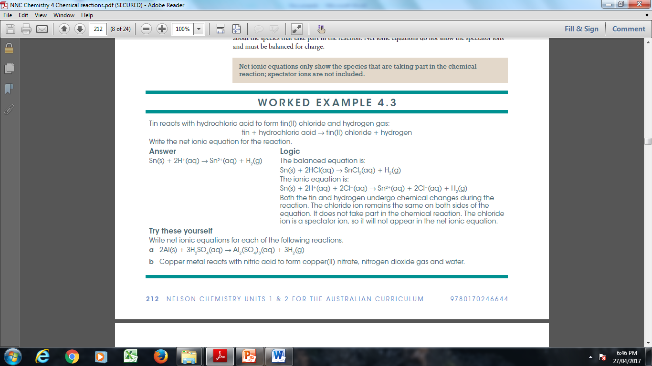


Slide 7
Do Question set: 4.2 - Q: 3, 4 and 5( a and d)

